Slide 1





Making Formal Methods work in Industrial Practice
Jyotirmoy V. Deshmukh
Joint work with:
Xiaoqing Jin
Jim Kapinski
Hisahiro Ito
Ken Butts
Sriram S.
Aditya Zutshi
Alexandre Donzé
Sanjit A. Seshia
Nikos Arechiga
Paulo Tabuada
Ayca Balkan
TexPoint fonts used in EMF.
Read the TexPoint manual before you delete this box.: AAAAAAAAAAAAAA

Slide 2
You might ask…
What’s the problem?
Why don’t formal methods “just work?”
What is it mathematically and scientifically hard?
Do you have any solutions?
How do you manage to get paid?
Cool, what’s in it for me?
I have a hammer, do you have nails?

Slide 3
Verification & Validation for Automotive Control Systems
The Problem

Slide 4
Control System
Plant
Physical system
External inputs
+
Real-Time Software Program
Controller

Slide 5
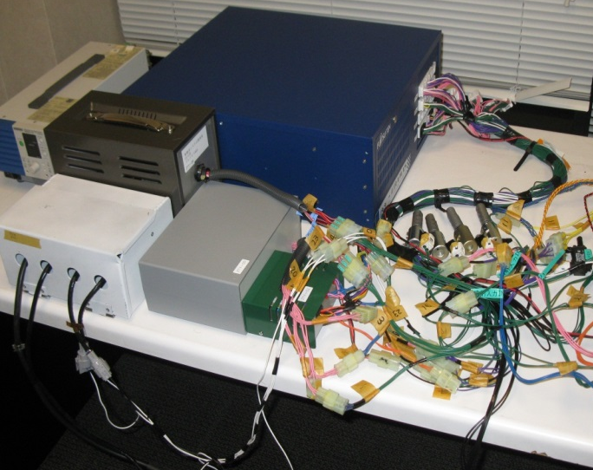

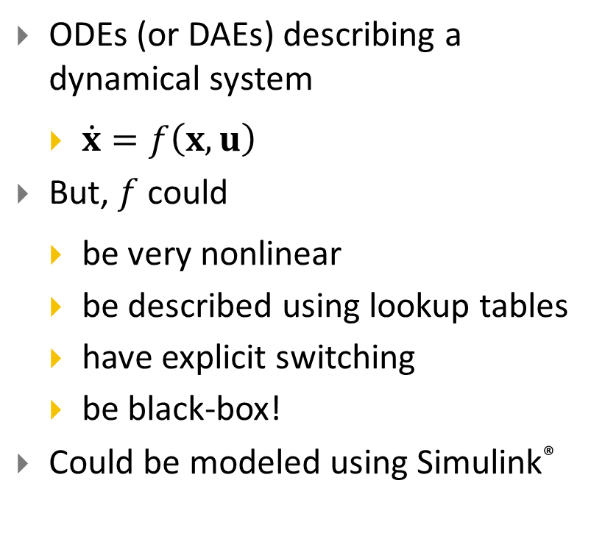
Plant models & Plant models
ODEs (or DAEs) describing a dynamical system
$\dot{x}=f\left(x,u\right)$
But, $f$ could
be very nonlinear
be described using lookup tables
have explicit switching
be black-box!
Could be modeled using Simulink®

Slide 6
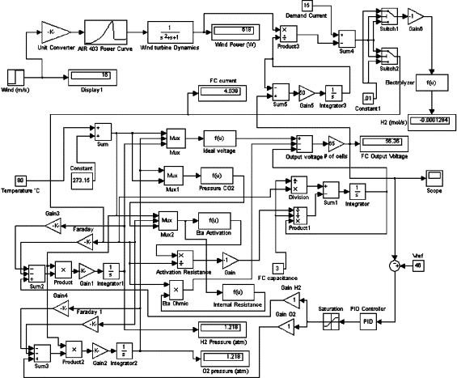
Controller
Before Model-Based Development
Soup of C functions including scheduler, event queues, interrupts, actual functionality, etc.
All communication through global variables
Mixture of time and event-triggered functions
With Model-Based Development
Block-diagram based language such as Simulink®
Hierarchical design
Time-triggered and event-triggered modules
Automatic Code Generation
Closed-loop testing

Slide 7


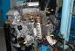

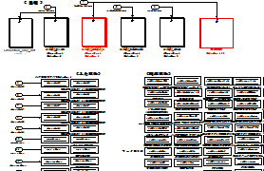
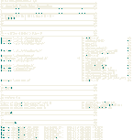
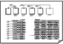
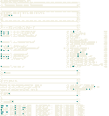
How are controllers designed in MBD?
Requirements and Design co-developed
Prototype
Design
Lots and lots of testing, now by driving!
System
evaluation
Legacy Code
Prototype modeling and
implementation
Lots and lots of testing
New design
Integrated
code
Requirement
Lots and lots of testing
Controller Specification Model
Auto-Code Generation

Slide 8
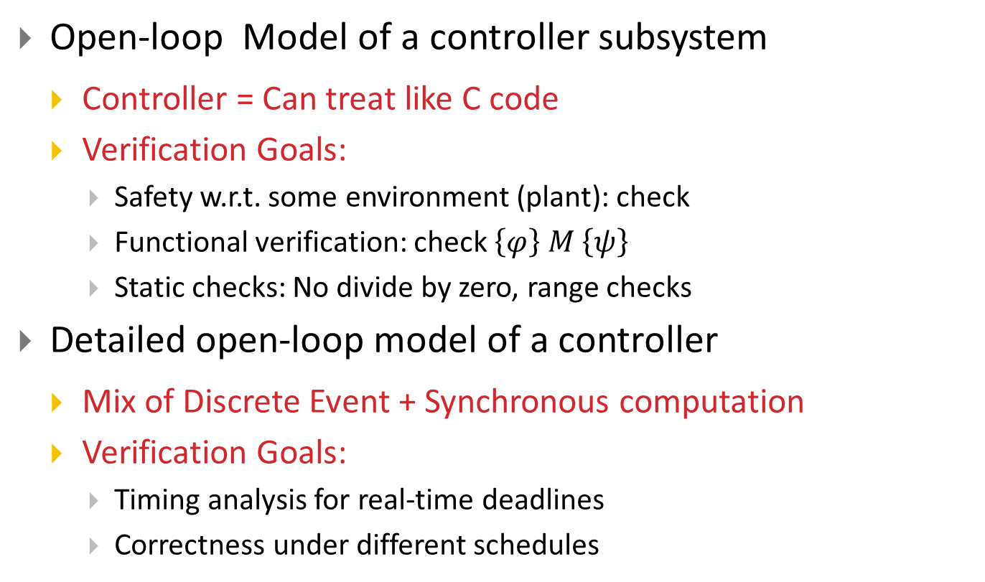
V&V Problem Spectrum: 1
Open-loop Model of a controller subsystem
Controller = Can treat like C code
Verification Goals:
Safety w.r.t. some environment (plant): check
Functional verification: check $\left\{φ\right\} M \left\{ψ\right\}$
Static checks: No divide by zero, range checks
Detailed open-loop model of a controller
Mix of Discrete Event + Synchronous computation
Verification Goals:
Timing analysis for real-time deadlines
Correctness under different schedules

Slide 9
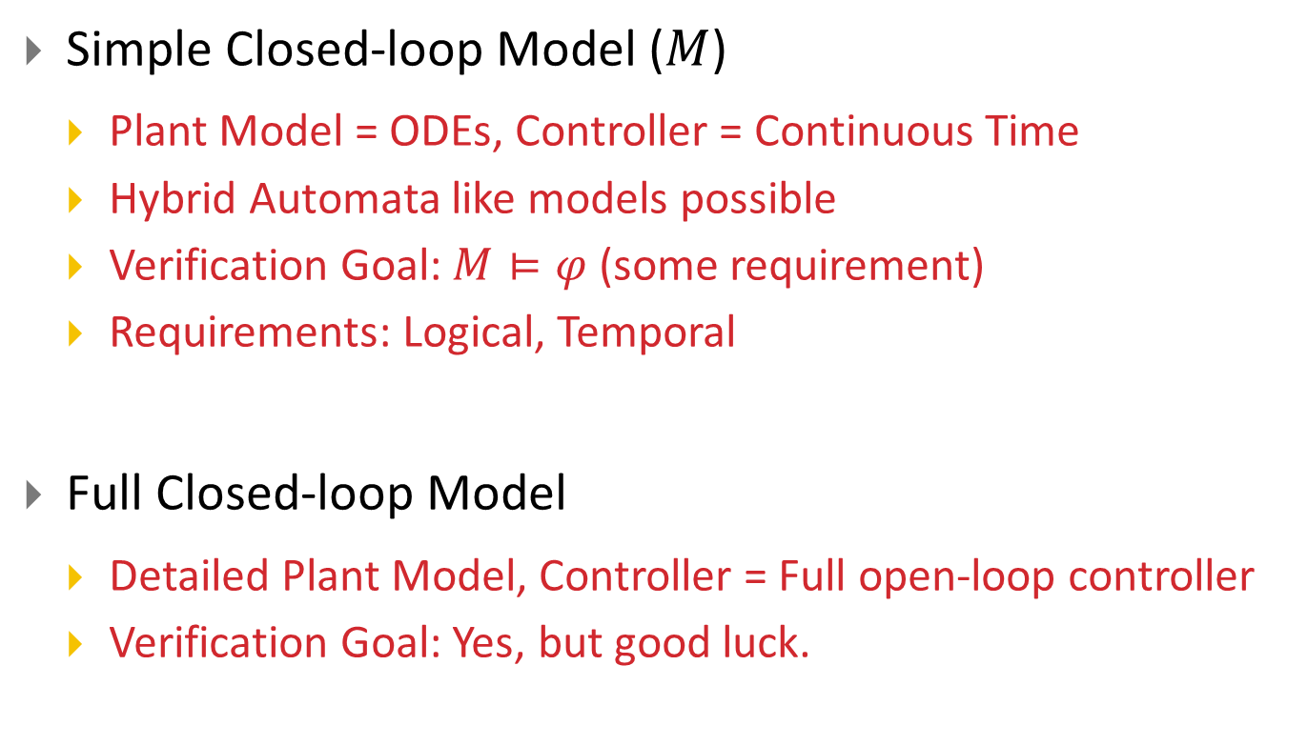
V&V Problem Spectrum: 2
Simple Closed-loop Model ($M$)
Plant Model = ODEs, Controller = Continuous Time
Hybrid Automata like models possible
Verification Goal: $M⊨φ$ (some requirement)
Requirements: Logical, Temporal
Full Closed-loop Model
Detailed Plant Model, Controller = Full open-loop controller
Verification Goal: Yes, but good luck.

Slide 10
Analysis Spectrum
Testing
Control Techniques
Verification
Can apply to real designs? (scalability)
Simulation
The One Tool to Rule Them All
Linear Analysis (numerical)
Test Vector Generation for Model Coverage
Unexplored Frontier
Concolic
Testing
Linear Analysis (symbolic)
(Bounded) Model Checking
Stability
Proofs
Theorem
Proving
Reachability
Analysis
How formal/exhaustive?

Slide 11
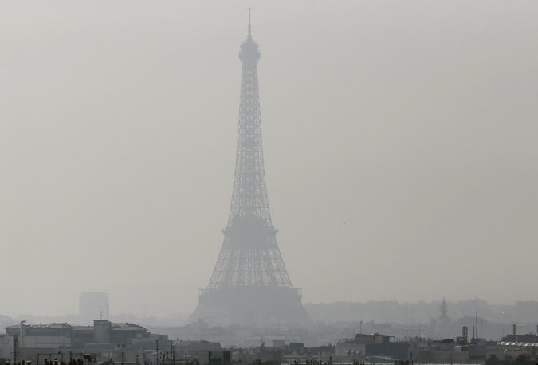
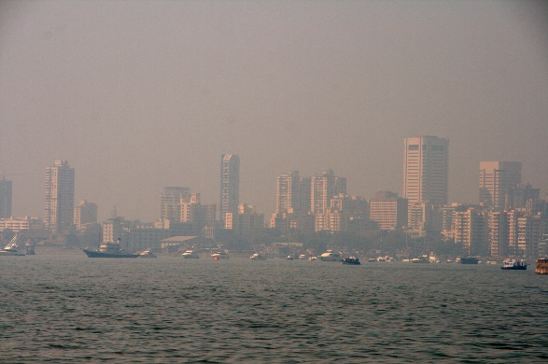

To give you a taste, here’s a “real” example [Jin et al. HSCC ‘ 14]
Paris
NY Times March 14 2014 © Getty images
Motivation
Controlling exhaust gas-emissions is important
Love of environment
Government Regulation
US CAFE requirements: 54.5 mpg by 2025
EU: 65 mpg by 2020
Mumbai
Christian Haugen’s Flickr
(Google image search)
Los Angeles
From Google image search

Slide 12
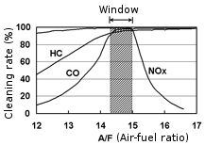
The key to emissions: Air to Fuel Ratio Control
Catalytic converters reduce HC, CO2, and NOx emissions
Conversion efficiency optimal at stoichiometric value

Slide 13
Gasoline Engine
Exhaust manifold
Fuel injectors
Measured A/F
Measured Air Flow
AIR
Intake manifold

Slide 14
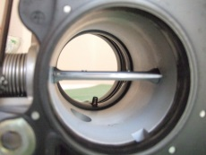
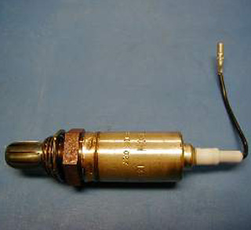
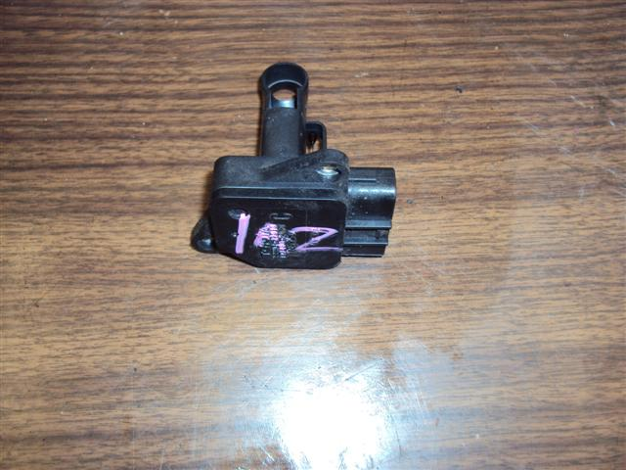
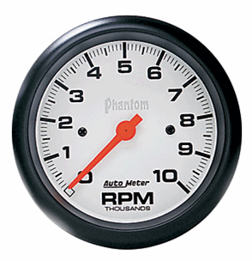
Mean-value Engine Model
Throttle Control +Air Dynamics
Intake Manifold
Measured Air Flow
Fuel Dynamics
Cylinder and
Exhaust
Measured A/F
Based on Guzella and Onder +
Simulink Demo palette +
our enhancements

Slide 15
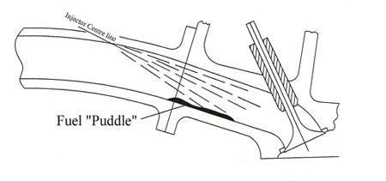
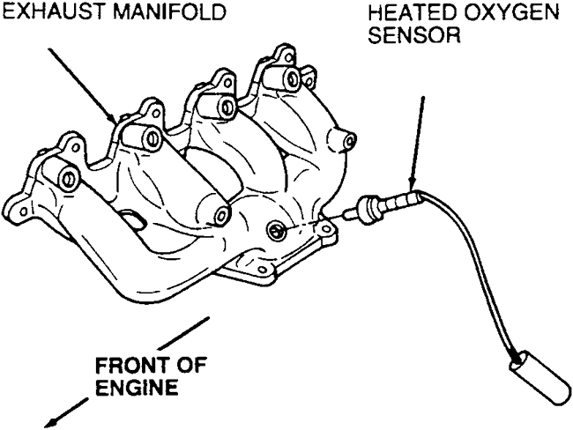
Dynamical phenomena and delays
Fuel puddling or Wall wetting
Exhaust Gas Variable Transport Delay
Fuel commanded
Exhaust entry
Fuel puddle
“wets” the wall
Actual fuel aspirated into combustion chamber
Transport Delay
O₂ sensor measures
A/F ratio

Slide 16
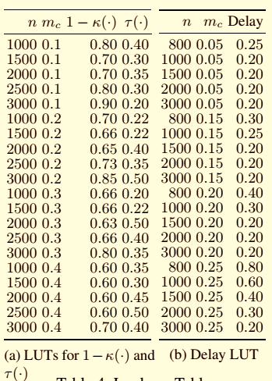
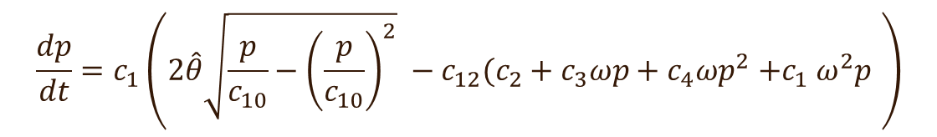
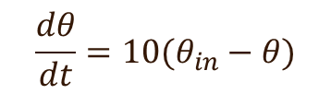
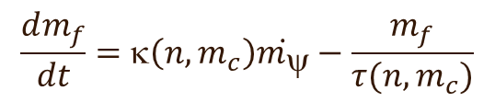
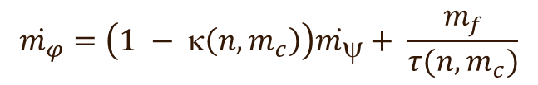
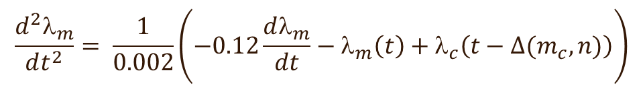
Engine Model (i.e. the Plant Model)
$$\frac{dθ}{dt}=10(θ_{in}−θ)$$
Delay Differential Equation
$$\frac{dp}{dt}=c_{1}\left(2\hat{θ}\sqrt{\frac{p}{c_{10}}−{\left(\frac{p}{c_{10}}\right)}^{2}} −c_{12}(c_{2}+c_{3}ωp+c_{4}ωp^{2}{+c}_{1}ω^{2}p \right)$$
$$\frac{d^{2}λ_{m}}{dt^{2}}= \frac{1}{0.002}\left(−0.12\frac{dλ_{m}}{dt}−λ_{m}\left(t\right)+λ_{c}\left(t−∆(m_{c}, n)\right)\right)$$
$$\dot{m_{φ}}=\left(1 − κ\left(n,m_{c}\right)\right)\dot{m_{ψ}}+ \frac{m_{f}}{τ(n, m_{c})}$$
$$\frac{dm_{f}}{dt}=κ\left(n,m_{c}\right)\dot{m_{ψ}}−\frac{m_{f}}{τ(n, m_{c})}$$

Slide 17
Control Problem for this Benchmark
Cylinder Air Flow Estimator/Observer
P+I Controller
Fuel
Command
Mode Logic
Measured Air Flow
Measured A/F

Slide 18

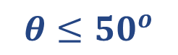
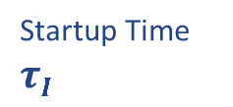
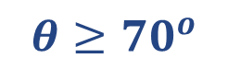



Controller: Discrete Updates at Δ ms intervals
startup
$$λ_{ref}=14.7$$
No Feedback Control
Only feedforward estimator
Startup Time $τI$
Feedback Control
+ Feedforward estimator
normal
$$λ_{ref}=14.7$$
$$θ≥{70}^{o}$$
$$θ≤{50}^{o}$$
sensor failure
power
$$λ_{ref}=14.7$$
$$_{ref}^{power}=12.5$$

Slide 19
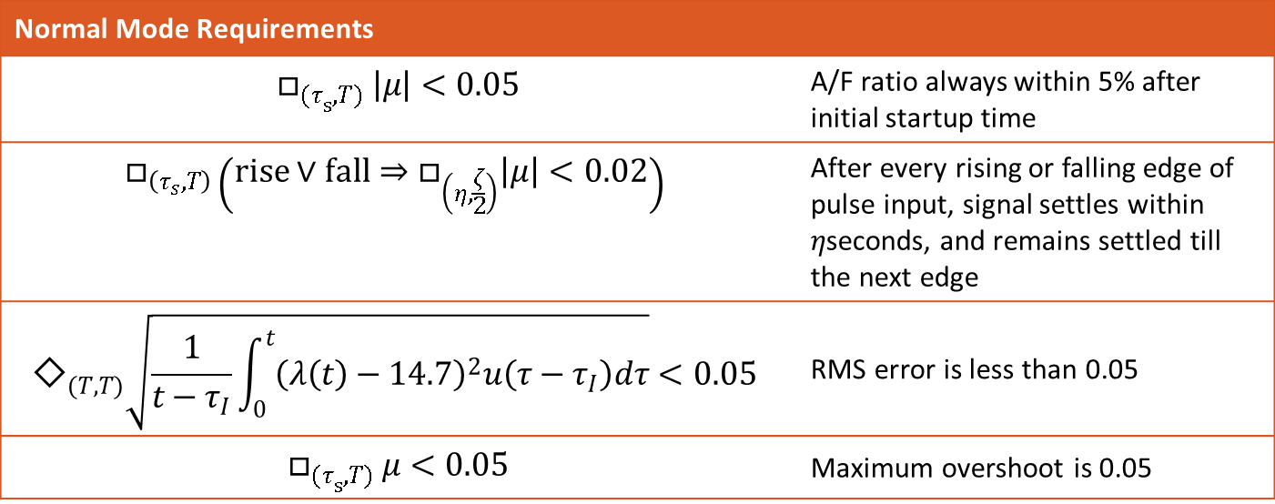
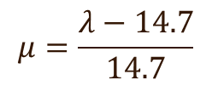
Example Requirements
$$μ=\frac{λ−14.7}{14.7}$$
Normalized A/F Ratio
Normal Mode Requirements
$$□_{{(τ}_{s}, T)} \left|μ\right|<0.05$$ | A/F ratio always within 5% after initial startup time
$$□_{\left(τ_{s},T\right)}\left(rise∨fall⇒□_{\left(η,\frac{ζ}{2}\right)}\left|μ\right|<0.02\right)$$ | After every rising or falling edge of pulse input, signal settles within $η$seconds, and remains settled till the next edge
$${\text{◇}}_{(T,T)}\sqrt{\frac{1}{t−τ_{I}}\int_{0}^{t}{{\left(λ\left(t\right)−14.7\right)}^{2}u\left(τ−τ_{I}\right)dτ}}<0.05$$ | RMS error is less than 0.05
$$□_{{(τ}_{s}, T)} μ<0.05$$ | Maximum overshoot is 0.05

Slide 20
The Challenge
Existing techniques cannot handle this “real” example
We have a simplified version to make it amenable to formal methods
But existing techniques may still struggle with the simplified version
But this example is much simpler than a really real example!
How can we verify or analyze such a model?
What hope do we have?

Slide 21
Simulation-Guided Formal Analysis
The Solution (tentative)

Slide 22

Why simulations? Engineers $♡$ Simulations
Help design validation
Provide visual feedback
Can uncover bugs
Do not require knowledge of:
Temporal Logic, SAT modulo theories, Bounded Model Checking; not even Hoare logic, Turing machines or Lambda-calculus!
Simulations are cheap and usually fast
Test-suites can be shared and built up across models

Slide 23
Simulation-Guided Formal Analysis: What it’s not
Is not a new algorithm that magically solves all problems
Is not a silver bullet for undecidable problems
May not guarantee
Soundness
Completeness
Termination
Optimality
a new label for “simulate till you find a bug and declare success, otherwise keep trying.”

Slide 24
Simulation-Guided Formal Analysis: What it is
A strategy
A data-driven approach
Makes some assumptions :
Traces easy to obtain and plentiful (almost always true)
Traces can be used to learn higher-level concepts
Can do guided search for simulations that refute learnt concepts

Slide 25
Some approaches we have tried
Mining temporal requirements for closed-loop models
Learning Lyapunov functions of nonlinear & hybrid systems
Learning contraction metrics for nonlinear systems

Slide 26
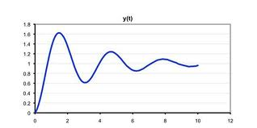

Requirements in Automotive Industry
How do engineers check correctness?
Performance requirements need to be identified

Slide 27
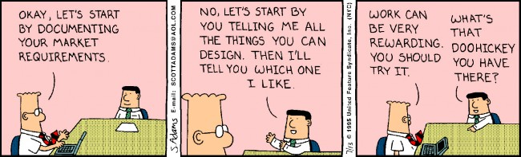
What is Requirement Extraction/Mining?
Ask designers what matters
Overshoot, settling time, relation between events
Translate designer interest into a “template”
Use Signal Temporal Logic (STL) for requirements, Parametric STL for templates (Donzé, Maler, et al.)

Slide 28
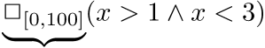
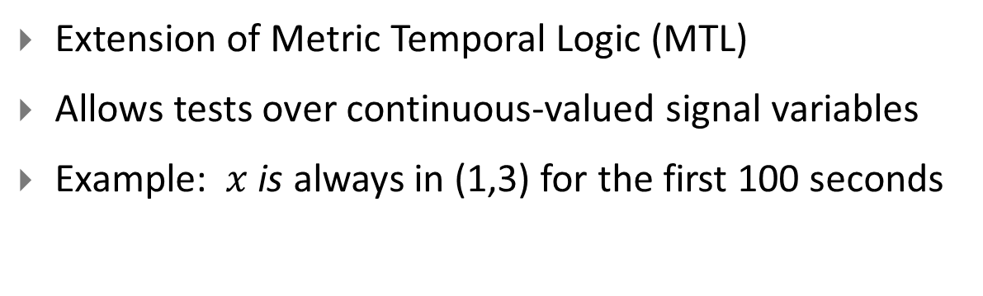
Signal Temporal Logic
Extension of Metric Temporal Logic (MTL)
Allows tests over continuous-valued signal variables
Example: $x$is always in (1,3) for the first 100 seconds
3
1
0
50
100
Always between time 0 and 100

Slide 29
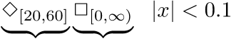
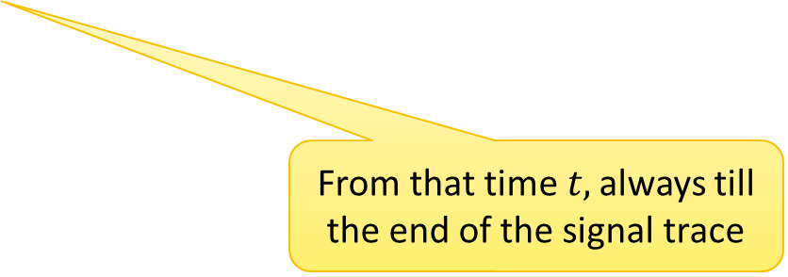
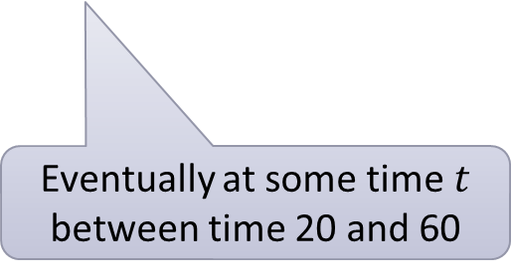
Signal Temporal Logic
Extension of Metric Temporal Logic (MTL)
Allows tests over continuous-valued signal variables
Example: settling time is between 20 and 60
1
+0.1
-0.1
60
0
100
Eventually at some time $t$ between time 20 and 60
From that time$t,$ always till the end of the signal trace

Slide 30
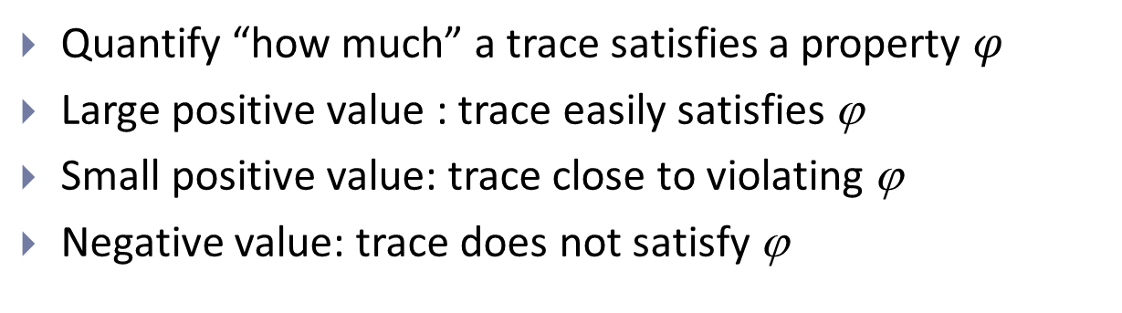
Robust Satisfaction of Signal Temporal Logic
Quantify “how much” a trace satisfies a property $φ$
Large positive value : trace easily satisfies ϕ
Small positive value: trace close to violating ϕ
Negative value: trace does not satisfy ϕ
Seminal work by Pappas and Fainekos: Robust Semantics for MTL
Quantitative semantics and efficient robust satisfaction value computation algorithms: Donzé, Maler, Ferrer et al.

Slide 31
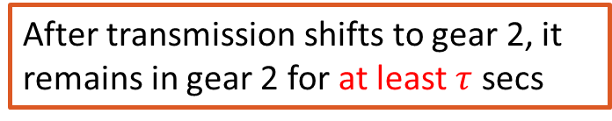
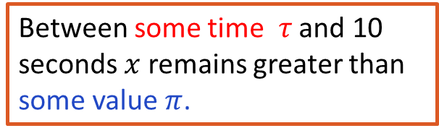
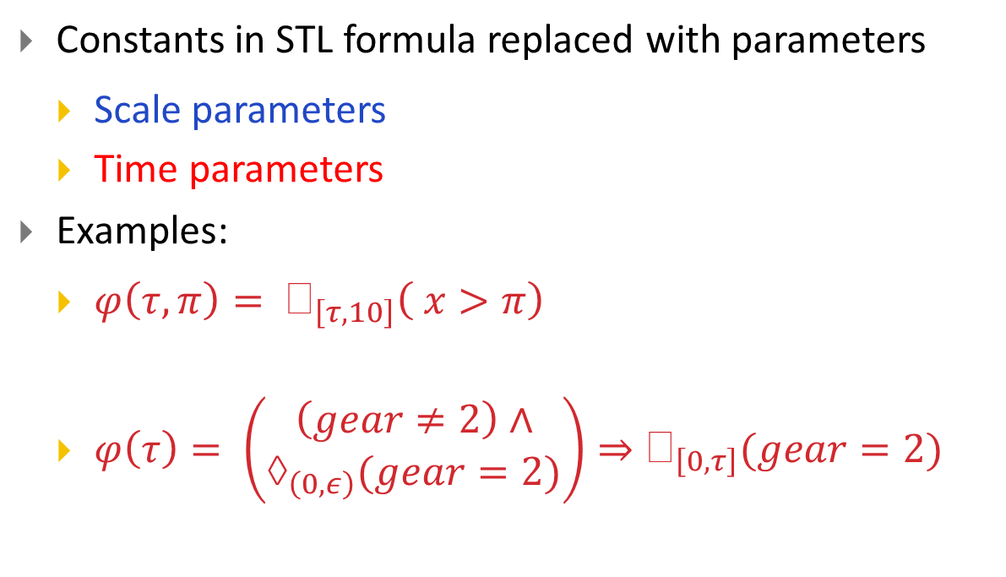
Parametric Signal Temporal Logic
Constants in STL formula replaced with parameters
Scale parameters
Time parameters
Examples:
$φ\left(τ, π\right)= _{\left[τ, 10\right]}\left( x>π\right)$
$φ\left(τ\right)= \left(\begin{matrix}\left(gear≠2\right)∧ \\ →_{\left(0,ε\right)}(gear=2)\end{matrix}\right)⇒_{\left[0,τ\right]}(gear=2)$
Between some time $τ$ and 10 seconds $x$ remains greater than some value $π$.
After transmission shifts to gear 2, it remains in gear 2 for at least $τ$ secs

Slide 32
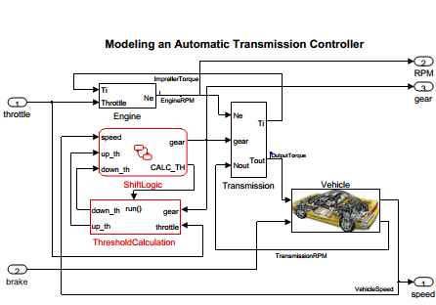
Requirement Mining using CEGIS [Jin et al. HSCC 2013]
Are there behaviors that do NOT satisfy these
requirements?
1.
1.
m.
n.
Counterexamples
Find “Tightest” Answers
Settling Time is 6.3 ms
Overshoot is 5.6 KPa
Upper Bound on x is 4.1
NO
Settling Time is ??
Overshoot is ??
Upper Bound on x is ??
Settling Time is 6.3 ms
Overshoot is 5.6 KPa
Upper Bound on x is 4.1

Slide 33
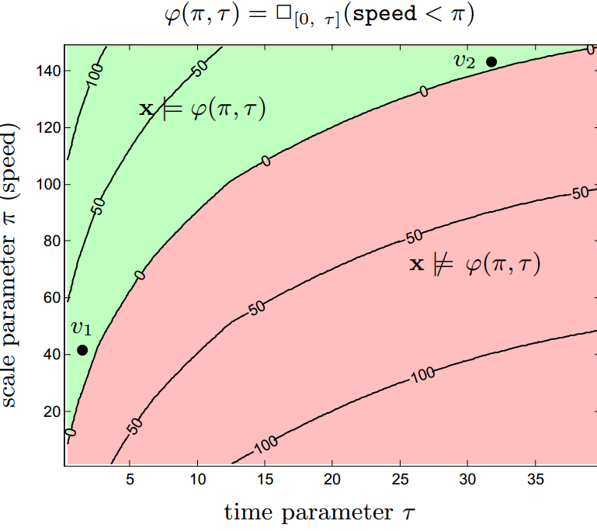
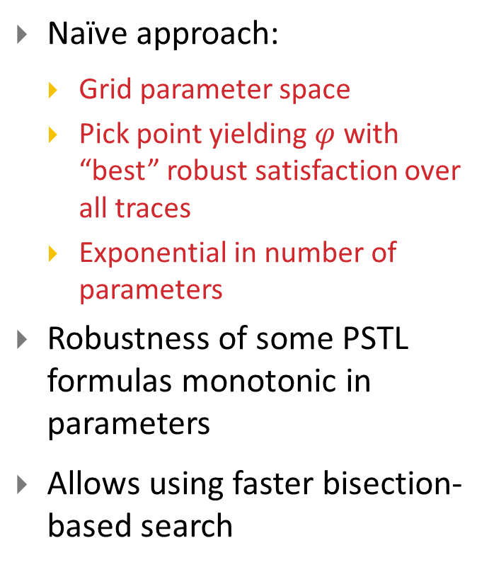
Learn Parameter Values from Traces
Naïve approach:
Grid parameter space
Pick point yielding $φ$ with “best” robust satisfaction over all traces
Exponential in number of parameters
Robustness of some PSTL formulas monotonic in parameters
Allows using faster bisection-based search

Slide 34
Refuting a candidate requirement: also simulation-guided
u
S(u)
\
\
Stochastic Global Optimizer
ϕ
Falsification Tools:
S-TaLiRo: Fainekos,
Sriram S.
Breach: Donzé
Minimize robustness value of ϕ
If ρ* < 0, found falsifying trace!

Slide 35


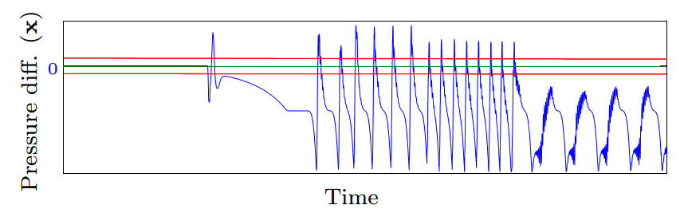
Demonstration
Mine maximum settling time:
stops after 4 iterations
gives answer t_{settle} = simulation time horizon (shown in trace below)
Experimental Engine
Control Model

Slide 36
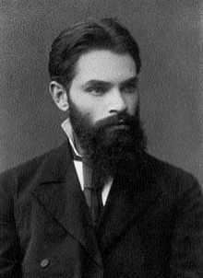
Finding Lyapunov Functions
With my direct method you can:
Prove stability
Prove set-invariance
Prove safety

Slide 37
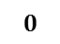
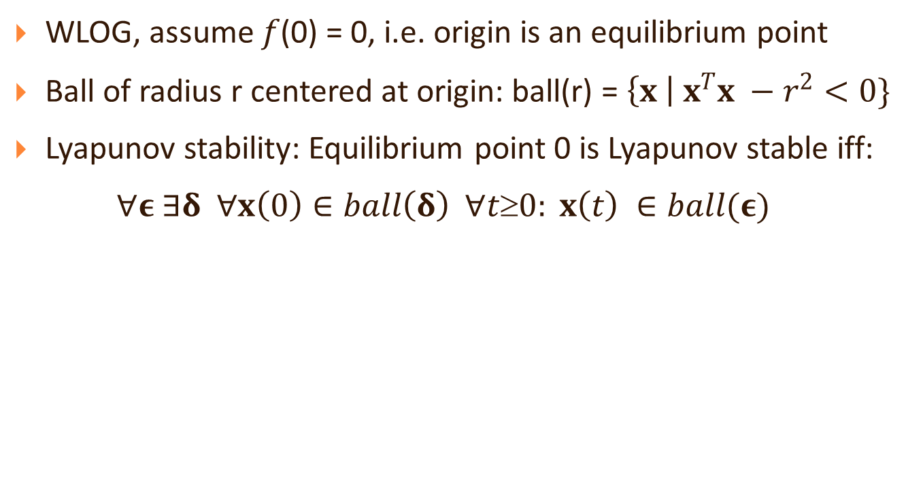



Quick Refresher: Lyapunov Stability
WLOG, assume $f$(0) = 0, i.e. origin is an equilibrium point
Ball of radius r centered at origin: ball(r) = $\left\{x \right| x^{T}x −r^{2}<0\}$
Lyapunov stability: Equilibrium point 0 is Lyapunov stable iff:
$∀ε ∃δ ∀x\left(0\right)∈ball\left(δ\right)$ $∀t≥0: x\left(t\right) ∈ball(ε)$
$$𝒟$$
x(0)
$$ε$$
$$δ$$
$$0$$
x(t)

Slide 38
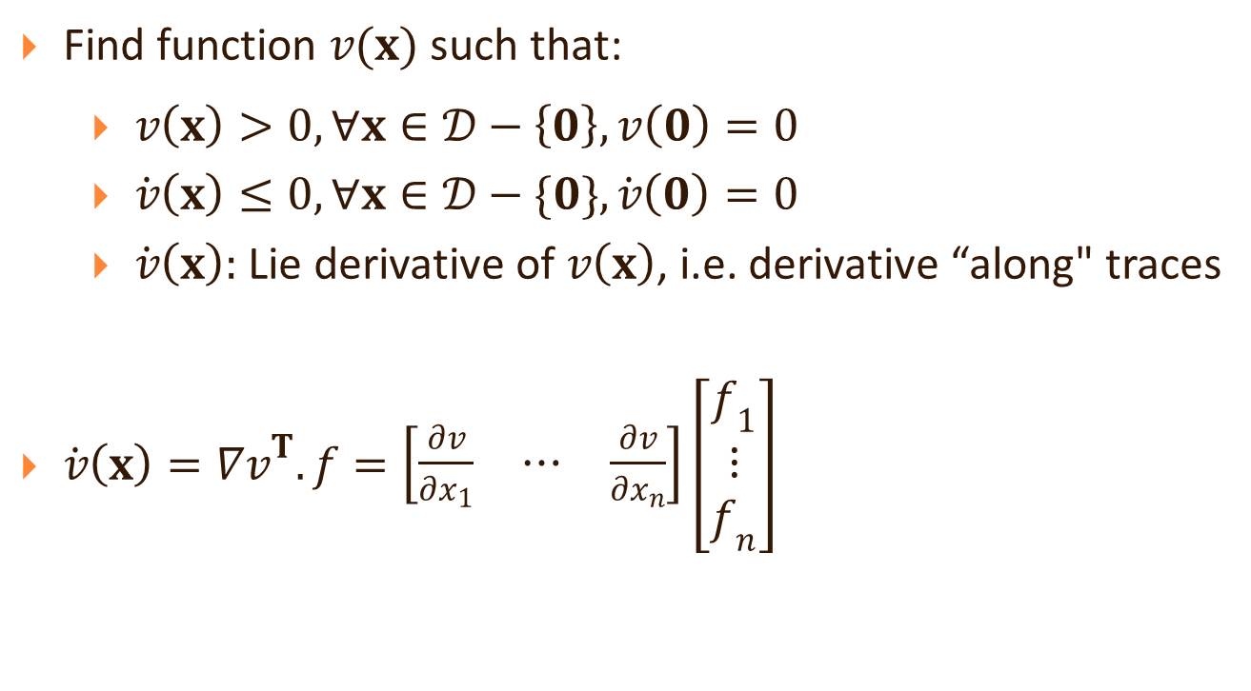
Quick Refresher: Lyapunov’s Direct Method
Find function $v(x)$ such that:
$v\left(x\right)>0,∀x∈𝒟−\left\{0\right\},v\left(0\right)=0$
$\dot{v}\left(x\right)≤0,∀x∈𝒟−\{0\},\dot{v}\left(0\right)=0$
$\dot{v}\left(x\right):$ Lie derivative of $v\left(x\right)$, i.e. derivative “along" traces
$\dot{v}\left(x\right)={∇v}^{T}.f=\left[\begin{matrix}\frac{∂v}{∂x_{1}} & ⋯ & \frac{∂v}{∂x_{n}}\end{matrix}\right]\left[\begin{matrix}f_{1} \\ ⋮ \\ f_{n}\end{matrix}\right]$

Slide 39

CEGIS of Lyapunov functions
Template
Candidate
Synthesize from
Simulations
+
Simulations
Falsify candidate with a global optimizer
Falsified!
Falsified!
Verify Lyapunov function/barrier/
invariant with SMT & other solvers

Slide 40
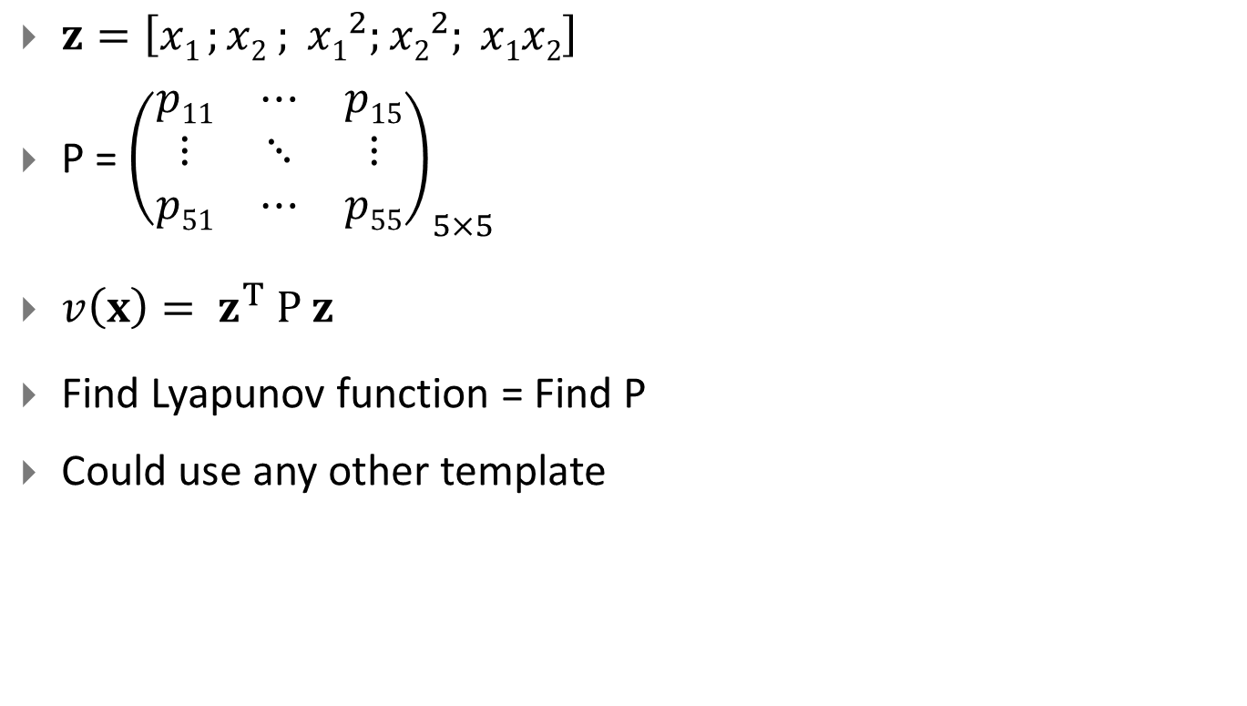
Template example: Sum of Squares* Polynomials
$z=\left[x1 ;x2 ; {x1}^{2};{x2}^{2}; x1x2\right]$
P = ${\left(\begin{matrix}p11 & ⋯ & p15 \\ ⋮ & ⋱ & ⋮ \\ p51 & ⋯ & p55\end{matrix}\right)}_{5×5}$
$v\left(x\right)= z^{T} P z$
Find Lyapunov function = Find P
Could use any other template
Pablo A. Parrilo. Structured Semidefinite Programs and Semialgebraic Geometry Methods in Robustness and Optimization. PhD thesis, California Institute of Technology, 2000.

Slide 41












Constraints from Traces
$$z=\left[x1 ;x2 ; {x1}^{2};{x2}^{2}; x1x2\right]$$
$$x1$$
$$x2$$
$$x3$$
$$x4$$
$$x5$$
$$x6$$
$$x10$$
$$x7$$
$$x8$$
$$x9$$
Inspired by Ufuk Topcu et al.’s Automatica paper.

Slide 42










Constraints from Traces
$$z=\left[x1 ;x2 ; {x1}^{2};{x2}^{2}; x1x2\right]$$
$$z1$$
$$z2$$
$$z3$$
$$z4$$
$$z5$$
$$z6$$
$$z10$$
$$z7$$
$$z8$$
$$z9$$
Inspired by Ufuk Topcu et al.’s Automatica paper.

Slide 43







Constraints from Traces
$v\left(x\right)= z^{T} P z$ > 0
$$z1$$
$${z1}^{T} P z1>0$$
$$z2$$
$${z2}^{T} P z2>0$$
$$z3$$
$$⋮$$
All z’s are vectors of numbers, not variables!
$$z4$$
$$⋮$$
$$z5$$
$$z6$$
$$z10$$
$$z7$$
$$z8$$
$$z9$$
$${z9}^{T} P z9>0$$
$${z10}^{T} P z10>0$$
Inspired by Ufuk Topcu et al.’s Automatica paper.

Slide 44






Constraints from Traces
$$\frac{d}{dt}v\left(x\right)≈ \frac{v\left(x\left(∆\right)\right)−v\left(x\left(0\right)\right)}{∆}<0$$
$$z1$$
$$z_{1}^{T} P z1−z_{2}^{T}P z2>0$$
$$z2$$
$$z_{2}^{T} P z2−z_{3}^{T}P z3>0$$
$$z3$$
$$⋮$$
$$z4$$
$$⋮$$
$$z5$$
$$z6$$
$$z10$$
$$z7$$
$$z8$$
$$z9$$
$$z_{9}^{T} P z9−z_{10}^{T}P z10>0$$
Inspired by Ufuk Topcu et al.’s Automatica paper.

Slide 45

Get Candidate from Solving a Linear Program
Only unknown is P:
Solve LP
LP solver hopefully results in a point representing set of feasible Lyapunov function coefficients
Check if P ⊱ 0 a posteriori
$$z_{1}^{T}P z1>0$$
$$z_{2}^{T}P z2>0$$
$⋮$
$$z_{N}^{T}P zN>0$$
$$z_{1}^{T} P z1−z_{2}^{T}P z2>0$$
$$z_{2}^{T} P z2−z_{3}^{T}P z3>0$$
$⋮$
$$z_{N−1}^{T} P{ z}_{N−1}^{}−z_{N}^{T}P z\text{N}\text{ >0}$$
(I)
(II)

Slide 46

Global Optimizer to refine candidate
$\frac{d}{dt}v\left(x\right)$ may not be negative everywhere in domain
Nelder-Mead optimizer to find min. of $−\dot{v}(x)$
$\min_{x1∈Ɗ}\left(\min_{i∈1..N−1}{v(x_{i})}−v\left(x_{i+1}\right)−γ{\left\|x_{i}\right\|}^{2})\right)$
I.e., find points where approx. Lie derivative is positive
Yes: add constraints from counterexample, re-compute candidate
No: Stop (global optimizer cannot find any more offending traces)

Slide 47
Are we done?
No! Global optimizer is not exhaustive
Know dynamics? Yes, then use:
Nonlinear SMT solvers
dReal, iSAT
z3
Algebraic solvers
Mathematica
QEPCAD
MetiTarski
Don’t know dynamics? Can still use sample and test under some conditions

Slide 48


Demonstration
Found barrier certificate:
$z=$ $\left[p, r, pest,i,p^{2},r^{2},p_{est}^{2},i^{2},p.r,p.pest,p.i,r.pest,r.i,pest.i\right]$
Monomial degree ≤ 2 [degree = 1 did not work]
P is a 14x14 matrix (eigenvalue max. = 489, min. = 7.6)
< 24 mins to compute P on desktop
dReal proved correctness of barrier in < 20 mins

Slide 49




Contraction Analysis
Interesting class of systems (such as control systems) are
contractive
Incrementally stable
convergent
Trajectories converge to each other as $t→∞$
Synonyms
$$y$$
Seminal paper by Lohmiller and Slotine
Recently rejuvenated by Forni and Sepulchre, Simpson-Porco and Bullo,
$$\left\|x−y\right\|$$
$$x$$

Slide 50

Motivation
We need a safety verification method that is based on finitely many simulations.
Given a trajectory of the system, it would be nice if we could conclude something about the nearby trajectories as well.

Slide 51

Contraction Metrics (Lohmiller & Slotine, Automatica, 98’)
Certificates of asymptotic convergence of trajectories to each other
Allows putting tubes around trajectories
Safety verification using finitely many simulations
(cf.“Verification of annotated models from executions”, Duggirala et.al., EMSOFT 13’)
Notes:
Too much text!

Slide 52

How do we establish contraction?
Autobisimulation functions
Lyapunov function on the “difference space”
$\dot{x}=Ax$, make a copy $\dot{y}=Ay$
Let $z=x−y$, then $\dot{z}=Az$
Find Lyapunov function $V\left(z\right)$for $\dot{z}=Az$
$V\left(z\right)$shows that as $t→∞, z →0$, i.e. $\left\|x−y\right\| →0$
Very easy to find for linear systems
So how hard can it be for nonlinear systems?
Seminal work on bisimulation functions by Girard and Pappas

Slide 53

Nonlinear systems
Autobisimulation functions almost impossible to find for nonlinear systems
“Why” needs reading papers on differential geometry, topology, geometric control
Contraction metrics alternative to autobisimulation functions
Intuition: Instead of a difference system, look at the differential system
Slotine’s idea:
$\dot{x}=f(x)$
$\dot{δx}=\frac{∂f}{∂x}δx$
Find “Lyapunov function” for this system

Slide 54

Contraction metrics for nonlinear systems
Contraction metric form: $δx^{T}M\left(x\right)δx$
Properties (much like Lyapunov functions)
$M\left(x\right)≻0$
$R\left(x\right)≺0$
$$R\left(x\right)= \frac{∂M\left(x\right)}{∂x}f\left(x\right)+M\left(x\right)\frac{∂f}{∂x}+{\left(\frac{∂f}{∂x}\right)}^{T}M\left(x\right)$$
Key difference: $M(x)$ is a matrix of polynomials
How to find these?
Aylward, Parrilo, Slotine: based on SoS optimization [Automatica ‘08]
Works for polynomial dynamical systems
What about nonpolynomial?

Slide 55

By now, you know the answer
Use simulations!
Fix $M\left(x\right)$as a template of polynomials
Once $x$ is a concrete simulation trace:
$M\left(x\right)≻0$ : becomes a Linear Matrix Inequality (LMI)
$R\left(x\right)≺0$: also becomes an LMI
Use semidefinite programming solvers (SeDuMi, SDPT3)
Verifying if $M\left(x\right)≻0$and $R\left(x\right)≺0$ with dReal more involved
Get characteristic function of the matrices
Check eigenvalues are positive (resp. negative) over all $x$

Slide 56
Demonstration
Found contraction metric valid over initial set of states
752 traces, < 8 minutes to find the contraction metric
A little over 2 hours to verify it with dReal

Slide 57
What’s in it for you
The Future

Slide 58
Explore more simulation-guided techniques
Simulation-guided Formal Analysis shows a lot of promise
Several future directions we are looking at:
Compositional approaches for barrier certificates (collaboration with Salar Moarref, Ufuk Topcu, and Rajeev Alur)
Using simulation-guided forward invariants to guide proofs of hybrid systems (collaboration with Nikos Arechiga, Bruce Krogh, Andre Platzer at CMU)
Learning temporal classifiers from traces
Simulation-guided conformance/equivalence checking (collaboration with Rupak Majumdar, Georgios Fainekos)
Can you use SiGFA for your work?

Slide 59
Beyond SiGFA: Challenge problems
Abstractions with formal guarantees
Abstract system:
satisfies same temporal requirements
has similar transient behavior
converges to original system asymptotically
is stability-preserving
is an over-approximation
Reachable set estimation
Polynomial & Nonpolynomial dynamics
Delay Differential Equations
Lookup Tables

Slide 60

Thank you! Questions?

